Slide 1
Multiple linear regression
Mahru

Slide 2
What is Linear Algebra?
Linear algebra is the study of lines and planes, vector spaces and mappings that are required for linear transforms.
It is a branch of Mathematics typically concern matrices and vectors.
It is extremely useful in the field of Data Science and Machine Learning as we often use matrices to represent a dataset.

Slide 3
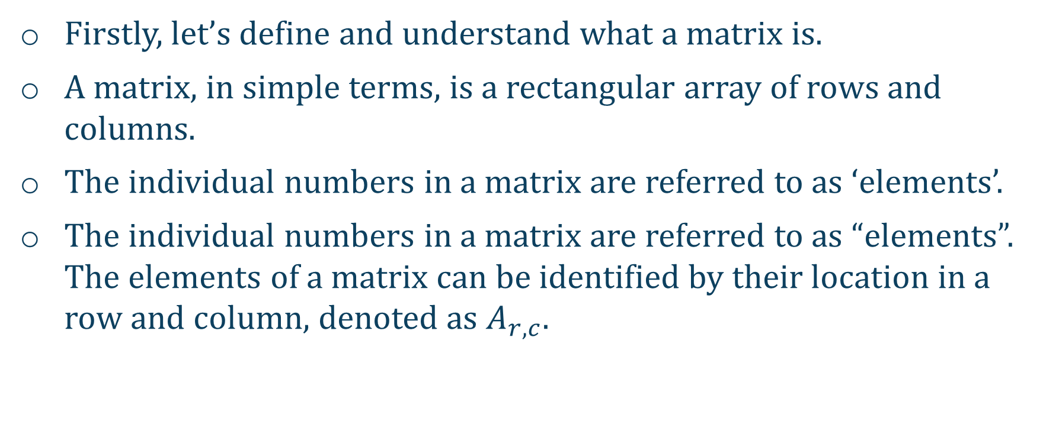
What is a matrix?
Firstly, let’s define and understand what a matrix is.
A matrix, in simple terms, is a rectangular array of rows and columns.
The individual numbers in a matrix are referred to as ‘elements’.
The individual numbers in a matrix are referred to as “elements”. The elements of a matrix can be identified by their location in a row and column, denoted as $A_{r,c}$.

Slide 4
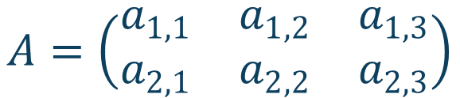
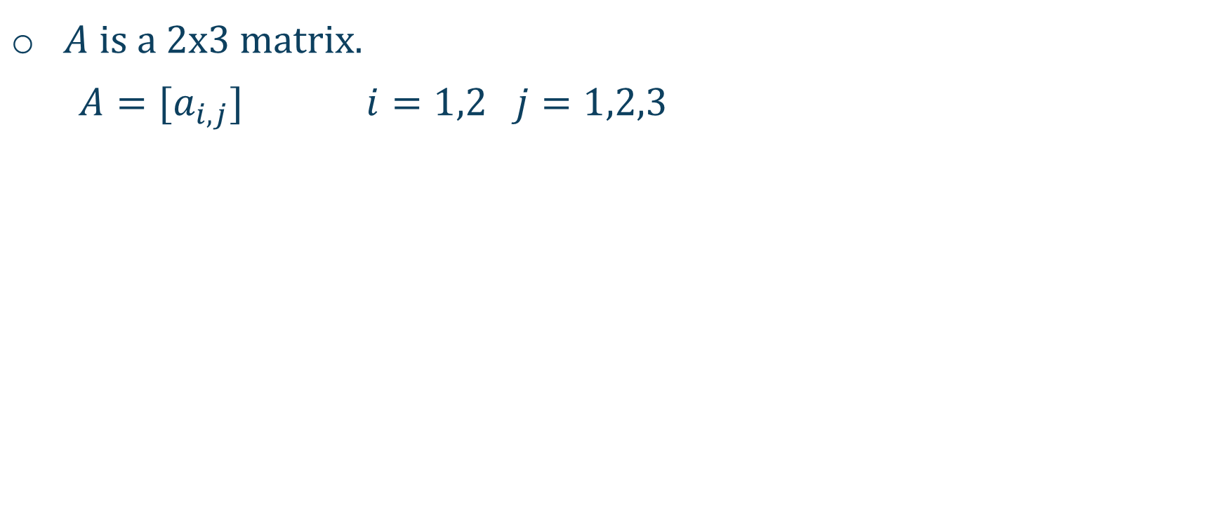
Matrices
$A$ is a 2x3 matrix.
$A=[a_{i,j}]$ $i=1,2 j=1,2,3$
Column Index
Row Index
$$A=\left(\begin{matrix}a_{1,1} & a_{1,2} & a_{1,3} \\ a_{2,1} & a_{2,2} & a_{2,3}\end{matrix}\right)$$

Slide 5
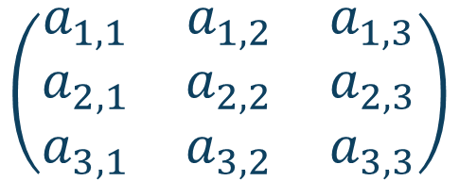
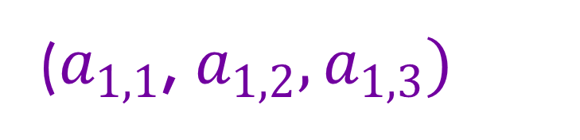
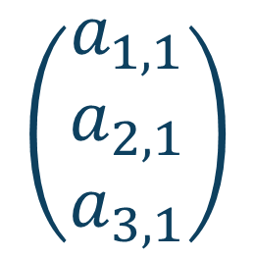
Linear Algebra Recap
Square matrix – Same number of rows and columns.
Vector – column/row vector has 1 column/row
$$\left(\begin{matrix}a_{1,1} & a_{1,2} & a_{1,3} \\ a_{2,1} & a_{2,2} & a_{2,3} \\ a_{3,1} & a_{3,2} & a_{3,3}\end{matrix}\right)$$
$$\left(\begin{matrix}a_{1,1} \\ a_{2,1} \\ a_{3,1}\end{matrix}\right)$$
($a_{1,1}$, $a_{1,2},a_{1,3})$

Slide 6
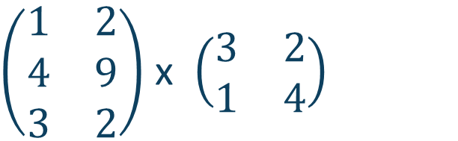
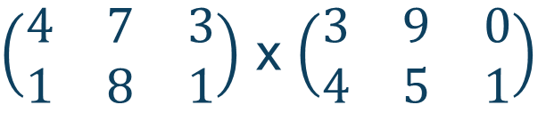
Linear Algebra
Multiplication: Tricker
The number of columns in the first matrix must match the number of rows in the second matrix.
$\left(\begin{matrix}1 & 2 \\ 4 & 9 \\ 3 & 2\end{matrix}\right)$ x $\left(\begin{matrix}3 & 2 \\ 1 & 4\end{matrix}\right)$
$\left(\begin{matrix}4 & 7 & 3 \\ 1 & 8 & 1\end{matrix}\right)$ x $\left(\begin{matrix}3 & 9 & 0 \\ 4 & 5 & 1\end{matrix}\right)$

Slide 7
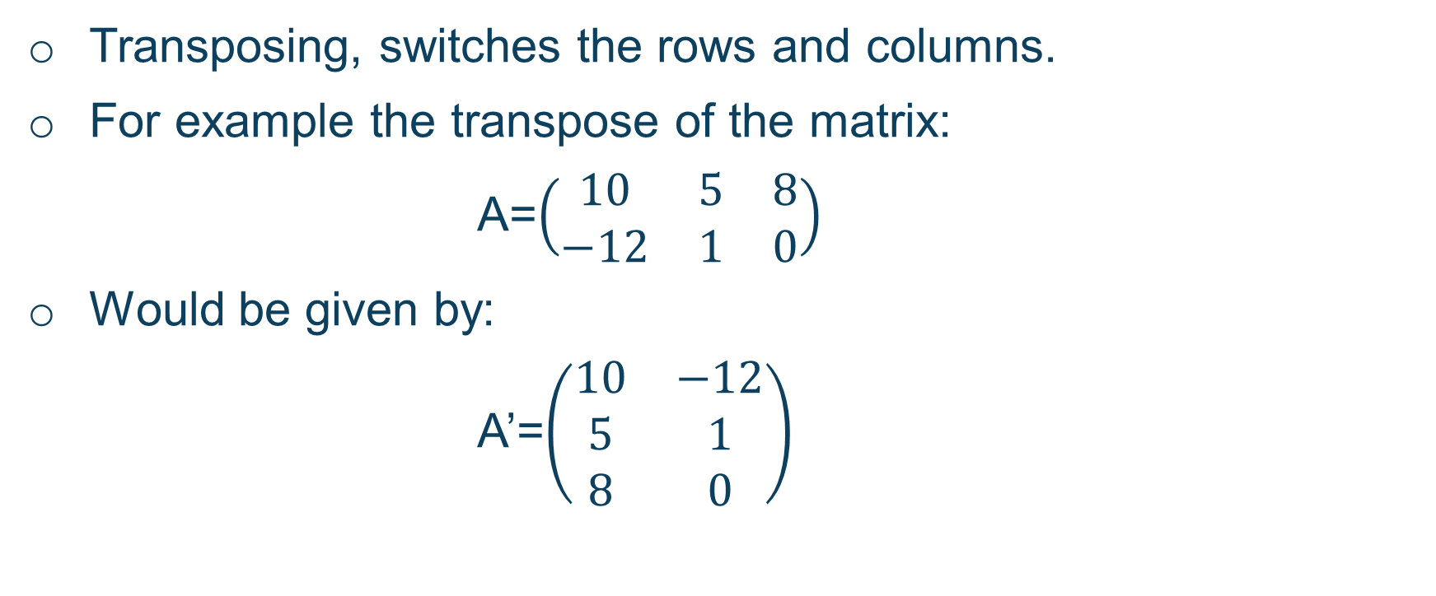
Fundamental Skills: Matrix Transpose
Transposing, switches the rows and columns.
For example the transpose of the matrix:
A=$\left(\begin{matrix}10 & 5 & 8 \\ −12 & 1 & 0\end{matrix}\right)$
Would be given by:
A’=$\left(\begin{matrix}10 & −12 \\ 5 & 1 \\ 8 & 0\end{matrix}\right)$

Slide 8
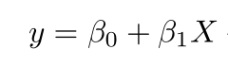
Simple Linear regression vs Multiple linear regression
Simple linear regression:
Simple linear regression allows us to study the relationship between only two variables:
One variable (X) – independent variable
Other variable (Y)- dependent variable

Slide 9
Simple regression
y is the predicted value of the dependent variable (y) for any given value of the independent variable (x).
B₀ is the intercept, the predicted value of y when the x is 0.
B₁ is the regression coefficient – how much we expect y to change as x increases.
x is the independent variable ( the variable we expect is influencing y).

Slide 10
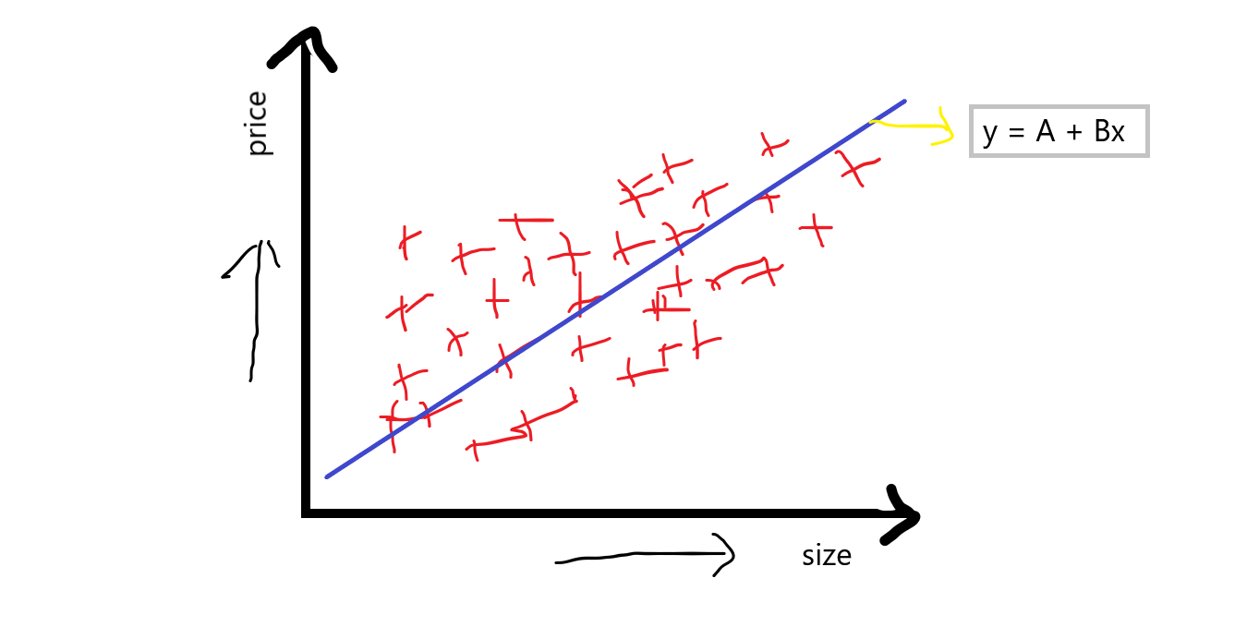
Simple regression
Let’s suppose we wanted to compare the size of a house and the price of a house, we can see there are two features.
We can graph this using the equation:
Y=A+Bx, where x denotes the size of the
house.
This can then be implemented on python.
The goal is to:
Find a correlation
Best line of fit
Dependent variable is changing as we change the independent variable.

Slide 11
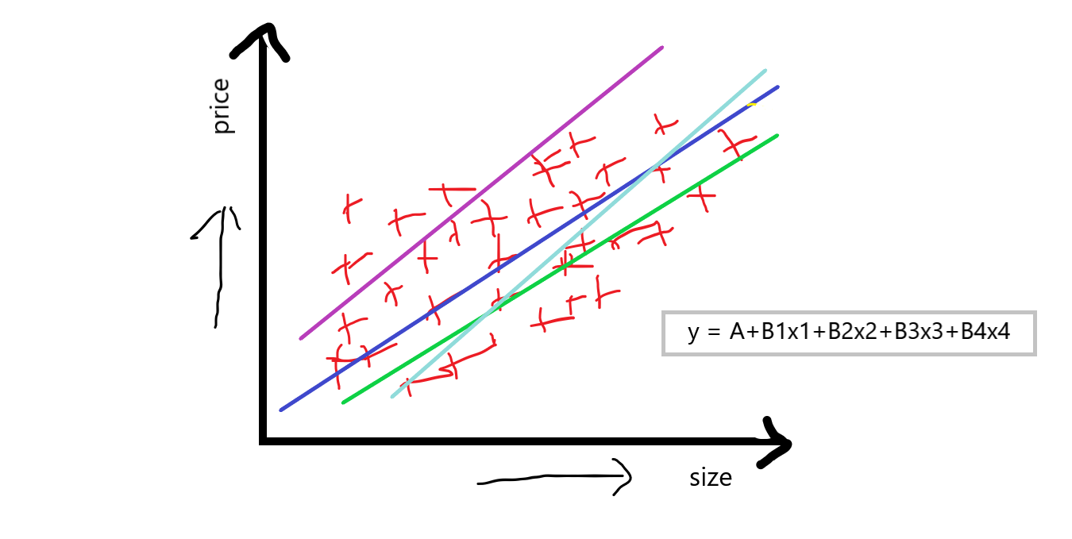
Multiple Linear regression
Multiple linear regression is when we have many features, looking at the previous problem we can see that was quite simple.
What if I wanted to find out whether amount of rooms, locality and condition of the house and other factors would affect the price ?
We’d get an equation of:
y = A+B₁x₁+B₂x₂+B₃x₃+B₄x_{4 + ….} B_{n}x_{n}

Slide 12
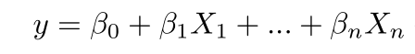
Multiple Linear Regression
y = the predicted value of the dependent variable
B₀ = the y-intercept (value of y when all other parameters are set to 0)
B₁X₁= the regression coefficient (B₁) of the first independent variable (X₁) (a.k.a. the effect that increasing the value of the independent variable has on the predicted y value)
… = do the same for however many independent variables you are testing
B_{n}X_{n} = the regression coefficient of the last independent variable

Slide 13
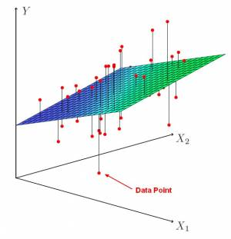
Multiple Linear regression
A hyperplane occurs during multiple linear regression.
Matrix Algebra can then be used to solve this.
Can be time consuming, so it is usually done using python for larger data sets which will be demonstrated.

Slide 14
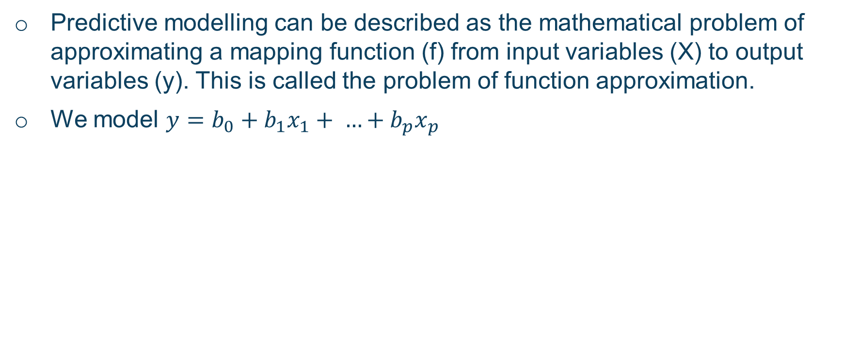
How does Linear Regression work?
Predictive modelling can be described as the mathematical problem of approximating a mapping function (f) from input variables (X) to output variables (y). This is called the problem of function approximation.
We model $y=b_{0}+b_{1}x_{1}+ …+b_{p}x_{p}$
Y | Our response variable
X | Our input variable
e | An error value our model cannot explain due to undetermined factors.
p | Predictors which we believe may explain our model.

Slide 15
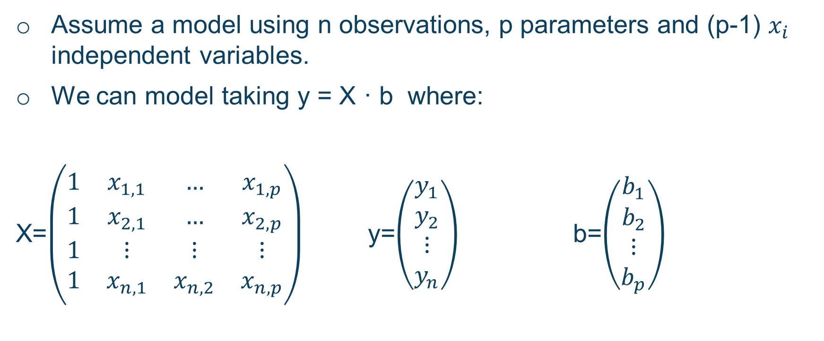
Linear Regression
Assume a model using n observations, p parameters and (p-1) $x_{i}$ independent variables.
We can model taking y = X · b where:
X=$\left(\begin{matrix}1 & x_{1,1} & … & x_{1,p} \\ 1 & x_{2,1} & … & x_{2,p} \\ 1 & ⋮ & ⋮ & ⋮ \\ 1 & x_{n,1} & x_{n,2} & x_{n,p}\end{matrix}\right)$ y=$\left(\begin{matrix}y_{1} \\ y_{2} \\ ⋮ \\ y_{n}\end{matrix}\right)$ b=$\left(\begin{matrix}b_{1} \\ b_{2} \\ ⋮ \\ b_{p}\end{matrix}\right)$
Input Data
Output Data
Vector of coefficients

Slide 16
Explaining the matrix form
Let’s remind ourselves what each matrix equation y = X · b + e represents and what its given dimensions are.
y | nx1 column vector of observations of the dependent variable
X | nxp matrix of observations of the Independent variables; first column 1’s.
b | px1 column vector of regression coefficients.

Slide 17
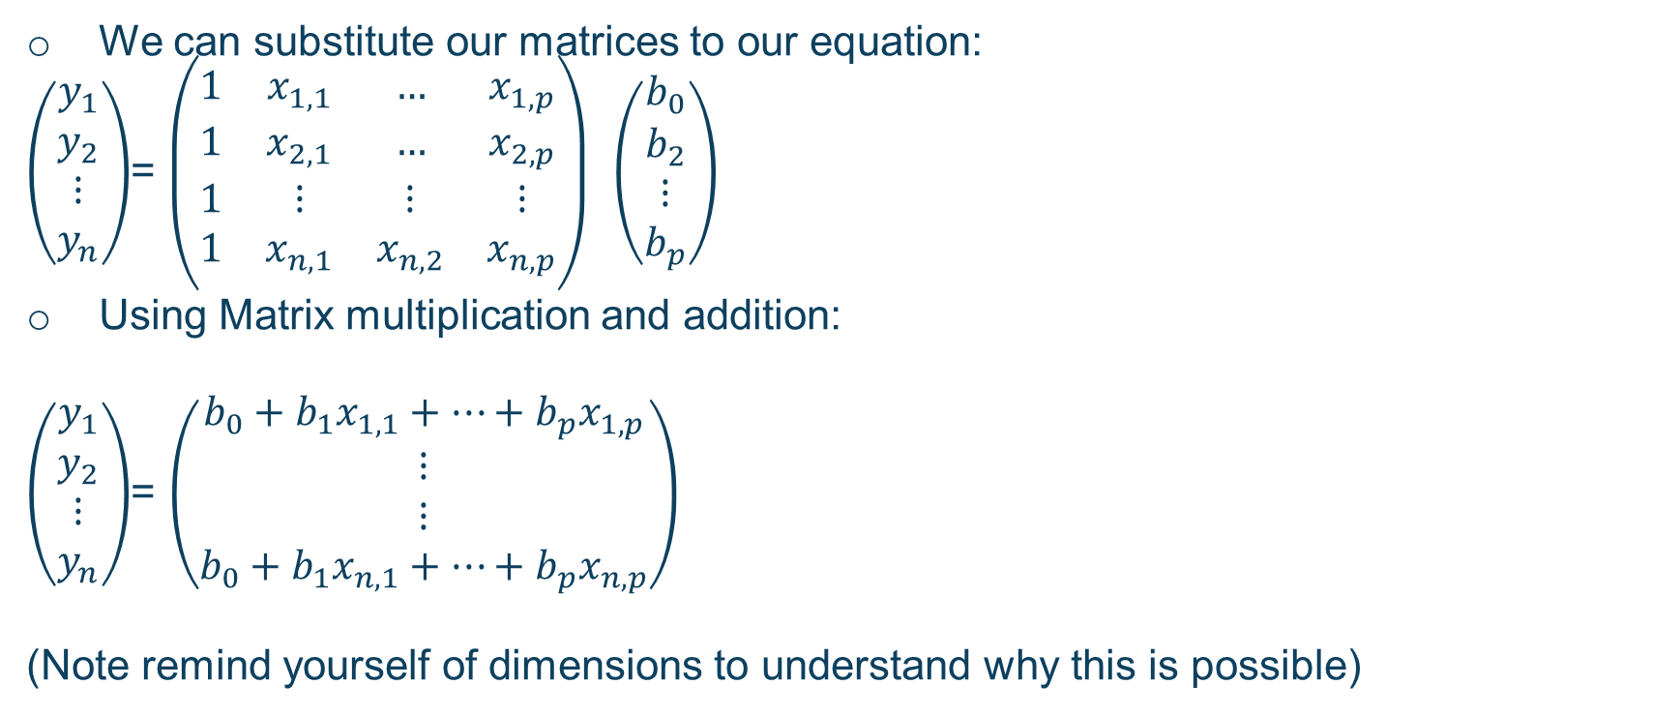
Using our matrix operations
We can substitute our matrices to our equation:
$\left(\begin{matrix}y_{1} \\ y_{2} \\ ⋮ \\ y_{n}\end{matrix}\right)$= $\left(\begin{matrix}1 & x_{1,1} & … & x_{1,p} \\ 1 & x_{2,1} & … & x_{2,p} \\ 1 & ⋮ & ⋮ & ⋮ \\ 1 & x_{n,1} & x_{n,2} & x_{n,p}\end{matrix}\right)$ $\left(\begin{matrix}b_{0} \\ b_{2} \\ ⋮ \\ b_{p}\end{matrix}\right)$
Using Matrix multiplication and addition:
$\left(\begin{matrix}y_{1} \\ y_{2} \\ ⋮ \\ y_{n}\end{matrix}\right)$= $\left(\begin{matrix}b_{0}+{b_{1}x}_{1,1}+…+{b_{p}x}_{1,p} \\ ⋮ \\ ⋮ \\ b_{0}+{b_{1}x}_{n,1}+…+{b_{p}x}_{n,p}\end{matrix}\right)$
(Note remind yourself of dimensions to understand why this is possible)

Slide 18
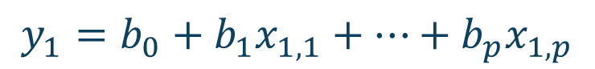
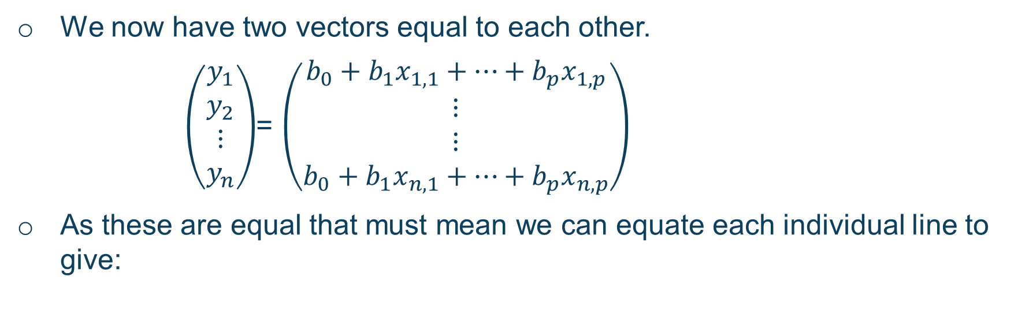
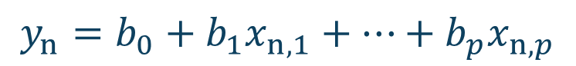

We now have two vectors equal to each other.
$\left(\begin{matrix}y_{1} \\ y_{2} \\ ⋮ \\ y_{n}\end{matrix}\right)$= $\left(\begin{matrix}b_{0}+{b_{1}x}_{1,1}+…+{b_{p}x}_{1,p} \\ ⋮ \\ ⋮ \\ b_{0}+{b_{1}x}_{n,1}+…+{b_{p}x}_{n,p}\end{matrix}\right)$
As these are equal that must mean we can equate each individual line to give:
$$y_{1}=b_{0}+{b_{1}x}_{1,1}+…+{b_{p}x}_{1,p}$$
$$⋮$$
$$⋮$$
$$y_{n}=b_{0}+{b_{1}x}_{n,1}+…+{b_{p}x}_{n,p}$$
This shows you the matrix equation we set up in our previous slide does indeed give us the equations we require.

Slide 19
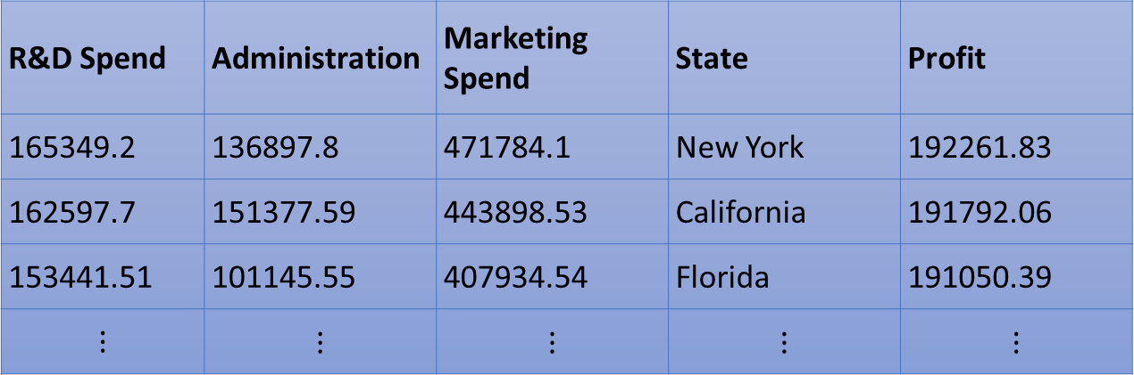
An example of multilinear regression
R&D Spend | Administration | Marketing Spend | State | Profit
165349.2 | 136897.8 | 471784.1 | New York | 192261.83
162597.7 | 151377.59 | 443898.53 | California | 191792.06
153441.51 | 101145.55 | 407934.54 | Florida | 191050.39
$$⋮$$ | $$⋮$$ | $$⋮$$ | $$⋮$$ | $$⋮$$
We are now going to investigate real-life application of multilinear regression
The above table shows multiple data features and we are going to model how columns 1-4 affect our profit.

Slide 20
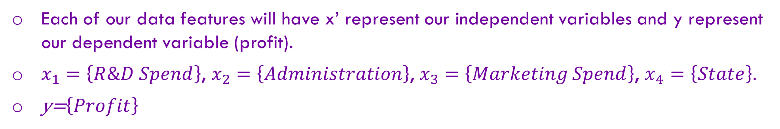
An example of multilinear regression
R&D Spend | Administration | Marketing Spend | State | Profit
165349.2 | 136897.8 | 471784.1 | New York | 192261.83
162597.7 | 151377.59 | 443898.53 | California | 191792.06
153441.51 | 101145.55 | 407934.54 | Florida | 191050.39
$$⋮$$ | $$⋮$$ | $$⋮$$ | $$⋮$$ | $$⋮$$
Each of our data features will have x’ represent our independent variables and y represent our dependent variable (profit).
$x_{1}=\left\{R\&D Spend\right\}$, $x_{2}=\left\{Administration\right\}$, $x_{3}=\left\{Marketing Spend\right\}$, $x_{4}=\left\{State\right\}.$
y=$\left\{Profit\right\}$

Slide 21
Metrics and Train-test Split
When carrying out multi linear regression on python, we will use metrics and train test split.
Usually use Scikit learn:
First set our variables, x to be the feature matrix and y to be response vector.
We then split our data set.
Next train our model.
Make predictions
Metrics are used

Slide 22
Metrics explained
Mean absolute error (MAE), Mean squared error (MSE), or Root mean squared error (RMSE).
MAE: The easiest to understand. Represents average error
MSE - harder to interpret than MAE as it’s not in base units, however, it is generally more popular.
RMSE: Most popular metric, similar to MSE, however, the result is square rooted to make it more interpretable as it’s in base units

Slide 23
MSE
Advantage: The MSE is great for ensuring that our trained model has no outlier predictions with huge errors, since the MSE puts larger weight on theses errors due to the squaring part of the function.
Disadvantage: If our model makes a single very bad prediction, the squaring part of the function magnifies the error. Yet in many practical cases we don’t care much about these outliers and are aiming for more of a well-rounded model that performs good enough on the majority.

Slide 24
MAE
Advantage: The beauty of the MAE is that its advantage directly covers the MSE disadvantage. Since we are taking the absolute value, all of the errors will be weighted on the same linear scale. MSE, we won’t be putting too much weight on our outliers and our loss function provides a generic and even measure of how well our model is performing.
Disadvantage: If we do in fact care about the outlier predictions of our model, then the MAE won’t be as effective. The large errors coming from the outliers end up being weighted the exact same as lower errors. This might results in our model being great most of the time, but making a few very poor predictions every so-often.

Slide 25
RMSE
Similarities: Both MAE and RMSE express average model prediction error in units of the variable of interest. Both metrics can range from 0 to ∞ and are indifferent to the direction of errors. They are negatively-oriented scores, which means lower values are better.
Differences: Taking the square root of the average squared errors has some interesting implications for RMSE. Since the errors are squared before they are averaged, the RMSE gives a relatively high weight to large errors. This means the RMSE should be more useful when large errors are particularly undesirable. The three tables below show examples where MAE is steady and RMSE increases as the variance associated with the frequency distribution of error magnitudes also increases.

Slide 26
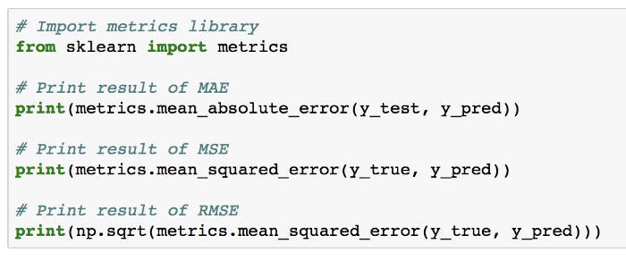
How metrics are used

Slide 27
Demonstration
We will use the following dataset:
https://archive.ics.uci.edu/ml/datasets/combined+cycle+power+plant
https://archive.ics.uci.edu/ml/index.php

